Slide 1

Assignment 4
Part 1
BDAT1001
Information Encoding Standard
Student Name: Money
Student Id: 200459799

Slide 2
In this Presentation we will perform authentication in different ways.
1. Authenticate pages by adding authentication rules.
2. Authenticate login user
3. Authenticate user JWT security

Slide 3
Authenticate pages by adding authentication rules.

Slide 4
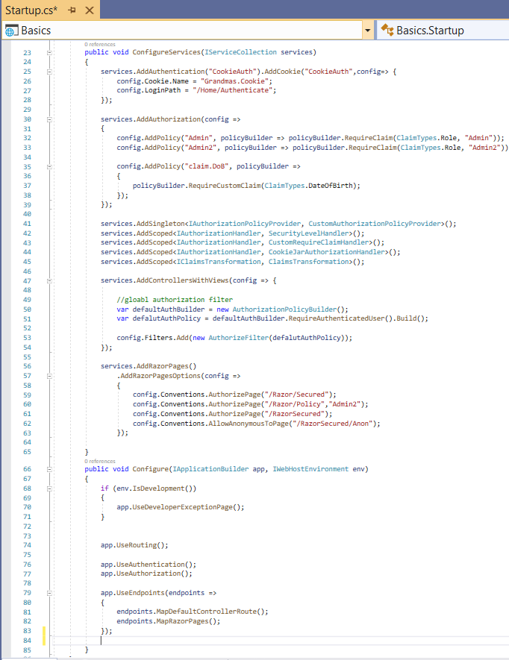
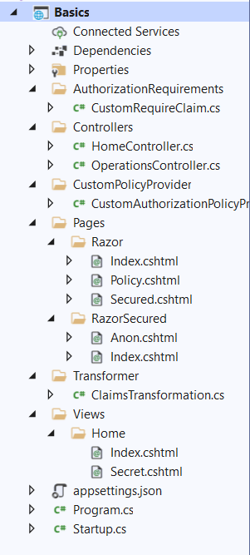
Authenticate pages by adding authentication rules
For this I have create a project with name ‘Basics’.
Then I have created some controllers, classes, html pages and razor pages and give structure to this project’s file as shown in diagram.
For authentication purpose I have also updated existing startup.cs , this is the main file project where we are defining all authentication policies and rules for application
In controller files, we will write all main code for user authentication.

Slide 5
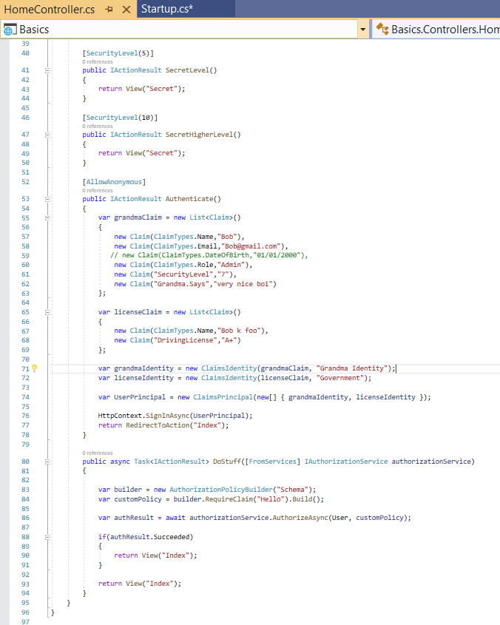
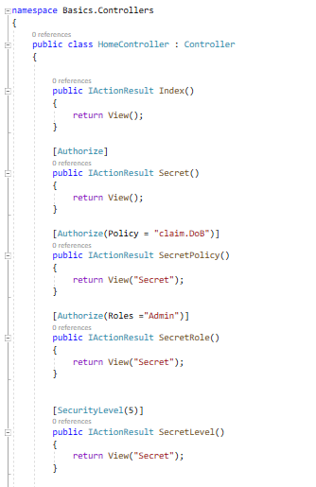
Authenticate pages by adding authentication rules
Code for Home Controller.
using System;
using System.Collections.Generic;
using System.Linq;
using System.Threading.Tasks;
using Microsoft.AspNetCore.Mvc;
using Microsoft.AspNetCore.Authorization;
using System.Security.Claims;
using Microsoft.AspNetCore.Authentication;
using Basics.CustomPolicyProvider;

Slide 6
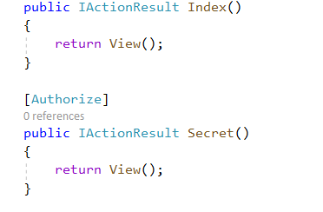
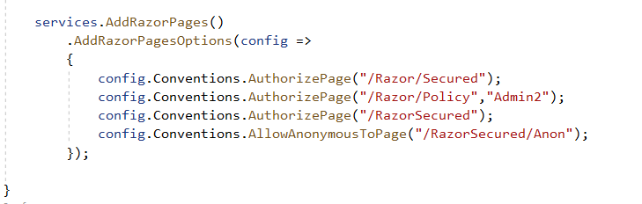
Authenticate pages by adding authentication rules.
In this project I have created some html pages (Home Page and Secret Page) and Razor pages (Index, Policy, Security and anon).
On simple html pages we applied security as per given screenshot.
For Razor pages security will be applied in below shown way.

Slide 7
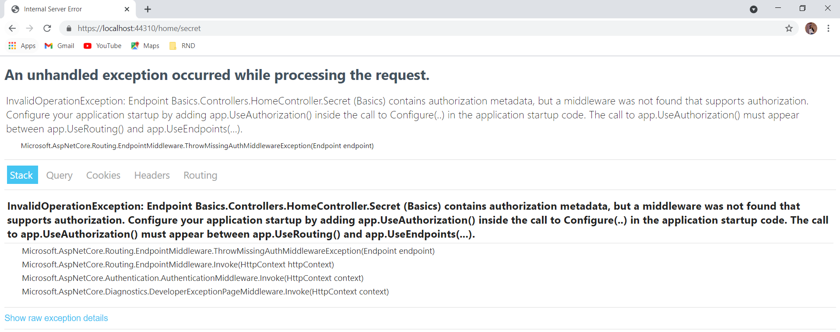
Authenticate pages by adding authentication rules.
Now after writing whole code in app when we will hit run and will try to reach Secret page from home page, an error will display that user is not authorizing.

Slide 8
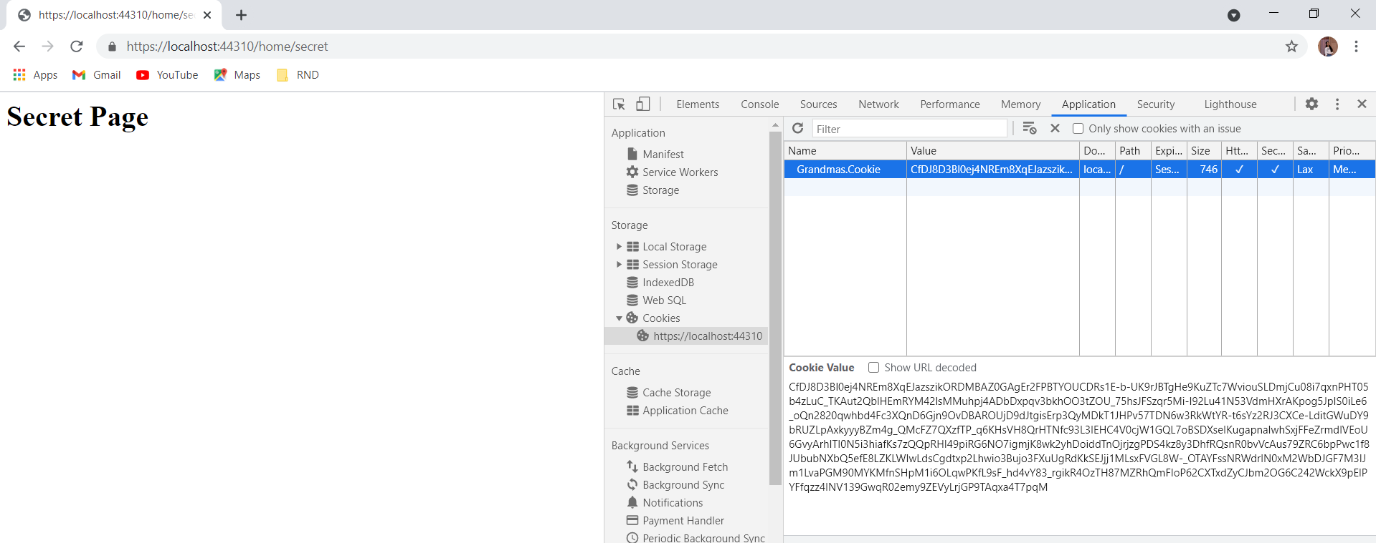
Authenticate pages by adding authentication rules.
Then to access the secret page we have created a cookie by which we will authenticate user to access Secret Page and this logic of creating and defining cookie is in Startup class and in Home controller. In Home controller some properties is defined.
Secret page having different authenticate checks, if user want to access secret page, then its properties should match with authenticate checks.

Slide 9
Authenticate login user

Slide 10
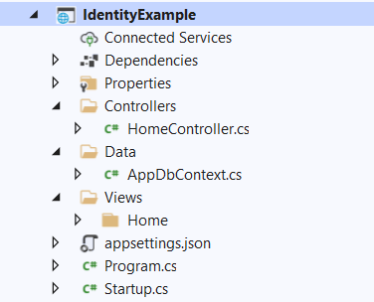
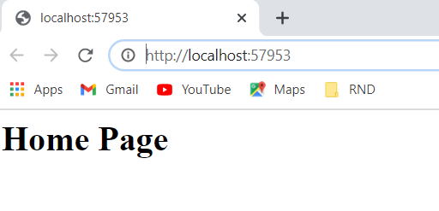
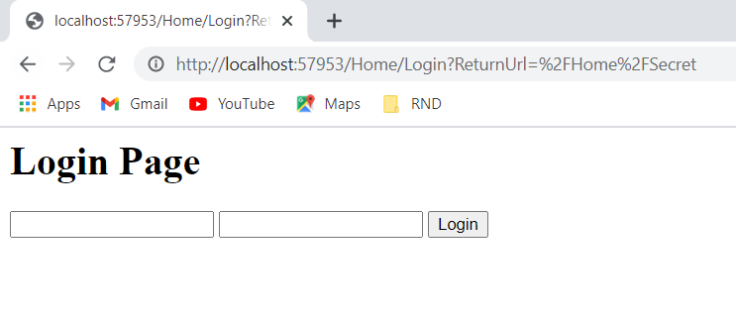
Authenticate login user
Our aim here is to verify login user.
To do so, We create a project Identity example in VS 2019 of ASP.Net core application.
In this project we will write all required code in the shown class classes in the given screenshot
After writing all code, when we will run the project, the first page will be our home page.
Now when I’m trying to access secret page from home page, I’ll automatically redirect to Login page because application want that user first verify itself to access secret page.

Slide 11
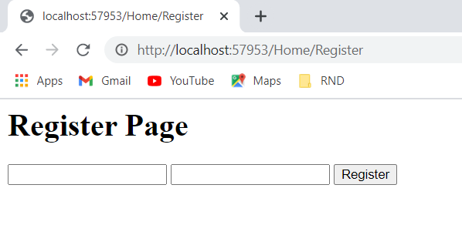
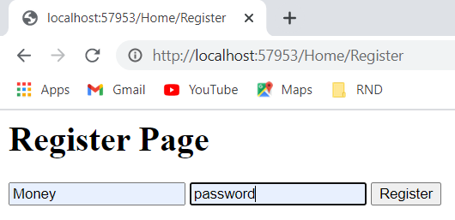
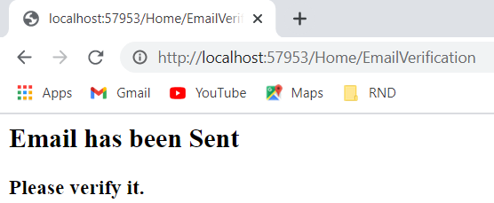
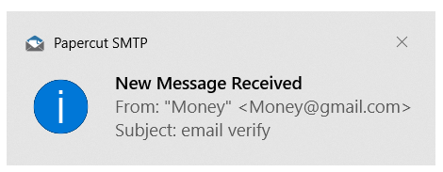
Authenticate login user
But here, before login user need to register itself and to do so we will go to register page.
Now on this page user can register and as soon as user register, a verification email will be sent to him.

Slide 12
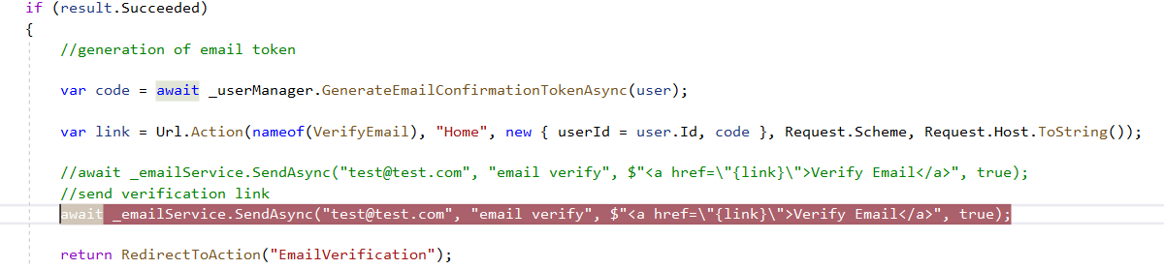
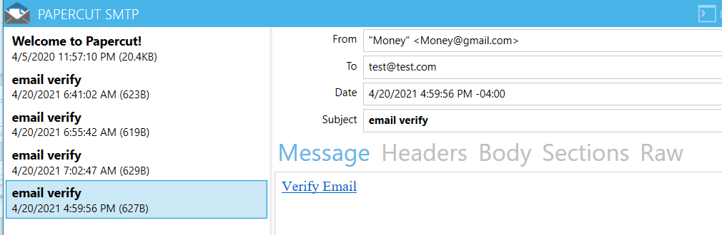
Authenticate login user
Now when user verify itself then login URL will appear to login. For this email verification we are using paper cut application.
This email will be sent from user which is defined in App Setting page to user which is given Home Controller page.
For all this email process we are using ‘NETCore.MailKit’ package.

Slide 13
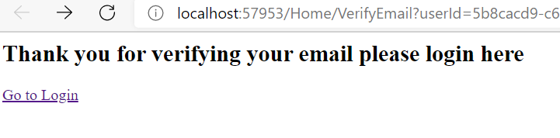
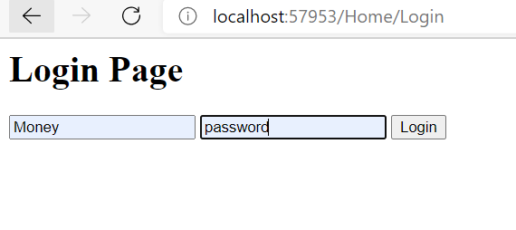
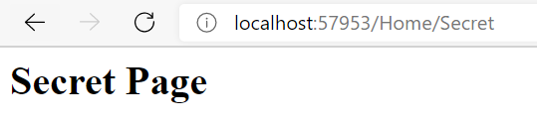
Authenticate login user
Once user click on verify link, then below screen will appear with thankyou message.
Now user can login by click on this go to login page. Here user have to login with same username and password which was used while registration.
Now user can access the secret page after verification process.

Slide 14
Authenticate user JWT security

Slide 15
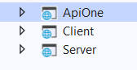
Authenticate user JWT security
Our aim here to authenticate user using Token.
To do so, We create 3 projects ApiOne, Client, Server.
Here we are using JWT for API security.
Basically, in this project are creating a secure that can be access by authenticated user and for authentication user will required a token.
All these 3 projects will run at the same time.
When application run, First client project will check is user is authenticated or not by calling authorize method defined in oauth controller in server project.
If user is authorized, then Authorize.cshtml will open where user must enter its name.
Now a token will generate for given user.
Then this generated token is expired or not will be checked by server and if the token expire then refresh token method will run to refersh the token. The life of refresh token is more then previous generated token
Now this token is correct or not will be checked by Api One, if token is correct then user will be able to access the api else authentication error will appear.

Slide 16
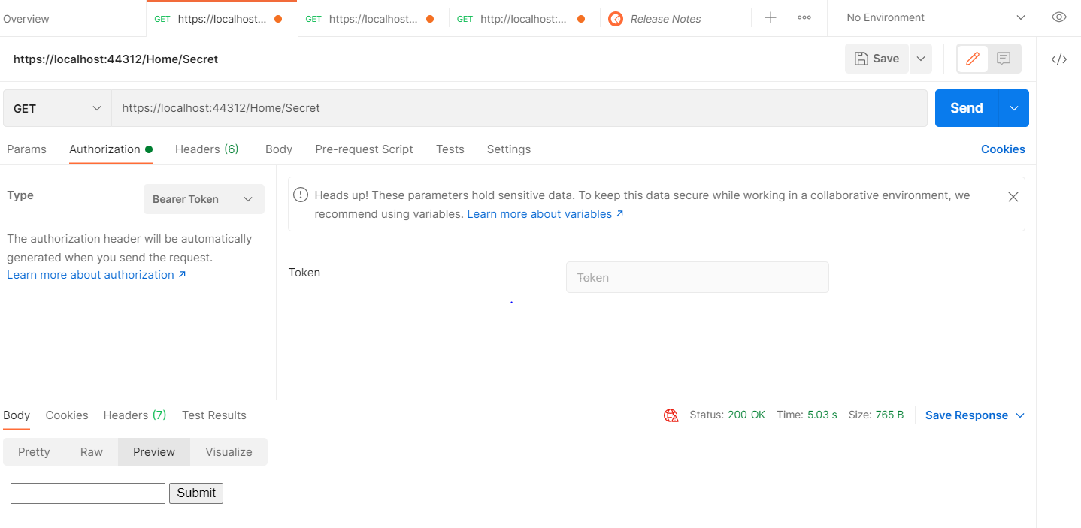
Authenticate user JWT security

Slide 17
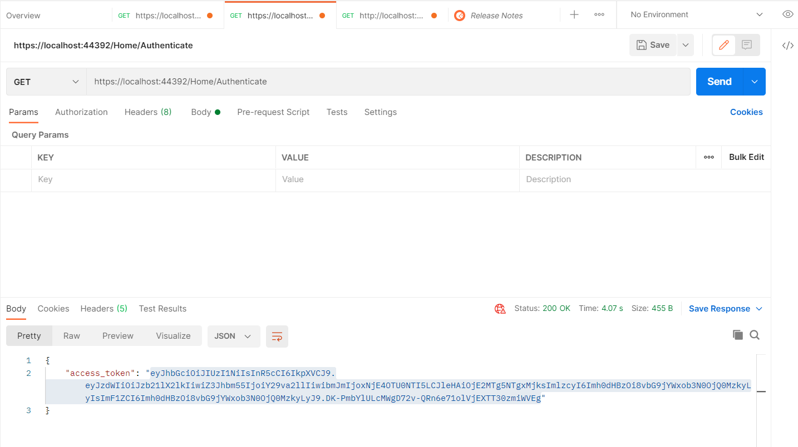
Authenticate user JWT security

Slide 18
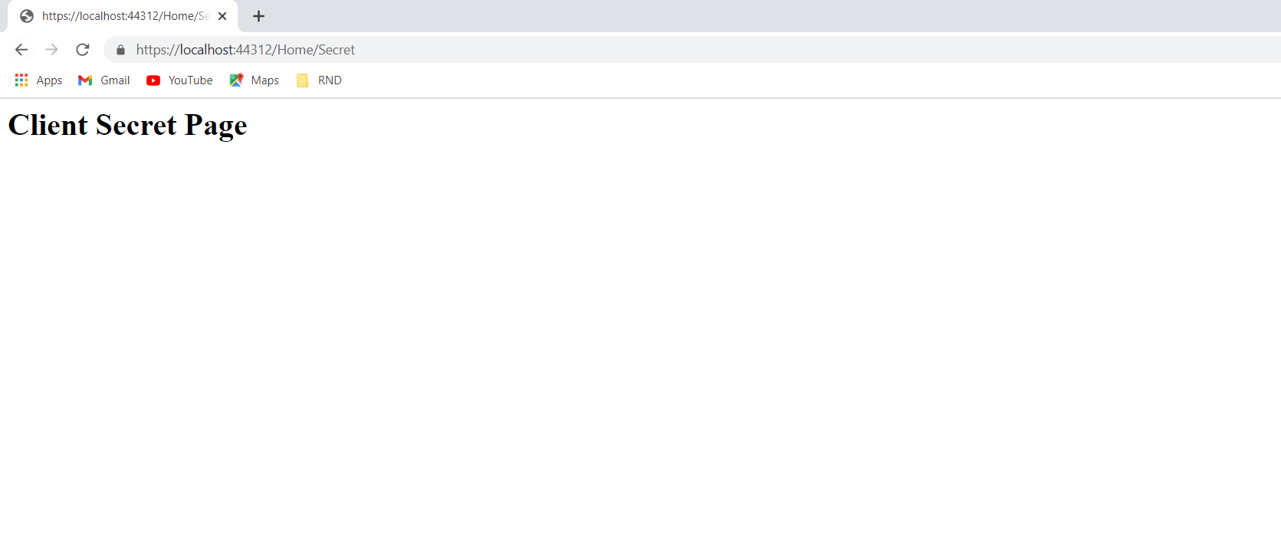
Authenticate user JWT security
After passing token, this token will be checked and if token is correct user will redirect to Secret page.

Slide 19
Video link: https://youtu.be/xlG54WeWjXs
Reference: https://www.youtube.com/playlist?list=PLOeFnOV9YBa7dnrjpOG6lMpcyd7Wn7E8V

Slide 20
Thank you

